Slide 1
GOOGLEPLAY STORE DATASET
BY
Hemanth Alva R
Sneha Jayaraman
Rohit Kumar A.S

Slide 2
DATASET ANALYSIS
THE DATASET CONSISTS OF 10K PLAYSTORE APPS FOR ANALYSING THE ANDROID MARKET.
IT CONSISTS OF 10841 ROWS AND 13 COLUMNS.

Slide 3

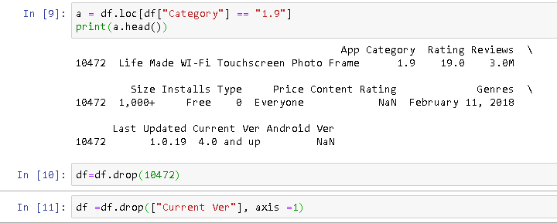
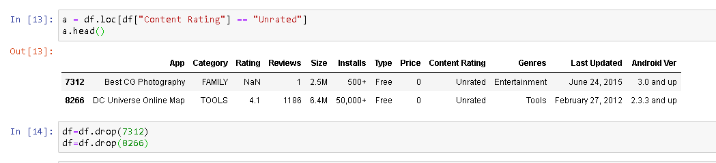

DATA CLEANING PERCENTAGE OF MISSING VALUES IS 13.72 OF DROPPING THE WRONGLY ENTERED ”1.9” CATEGORY DROPPING CURRENT VERSION COLUMN REMOVING ROWS WITH UNRATED CONTENT RATING DROPPING THE Nan rating ROWS

Slide 4
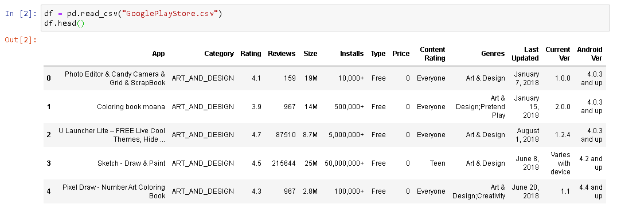
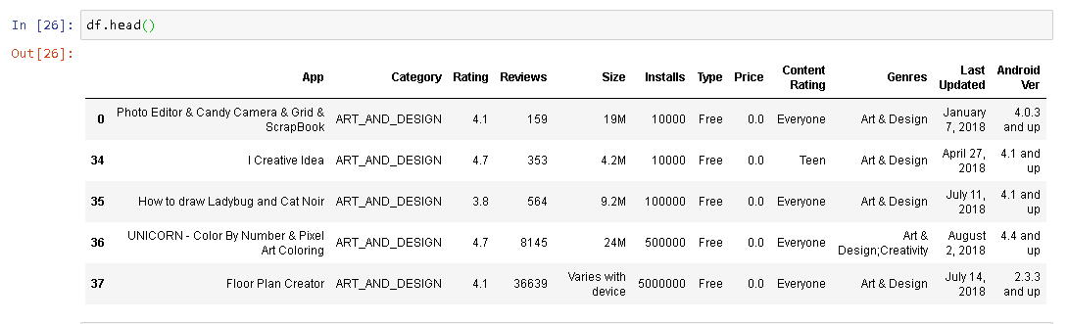
DATA CLEANING NO OF COLUMNS BEFORE CLEANING IS 13 NO OF COLUMNS AFTER CLEANING IS 12
BEFORE CLEANING
AFTER CLEANING

Slide 5
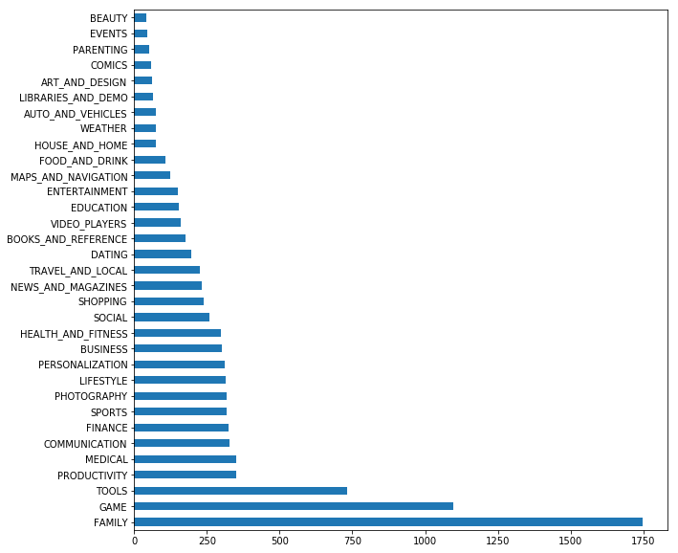
GRAPH VISUALISATIONS
GRAPH VISUALISATION
INSIGHTS : Maximum number of apps in Google play store belong to the Category Family and Game.

Slide 6
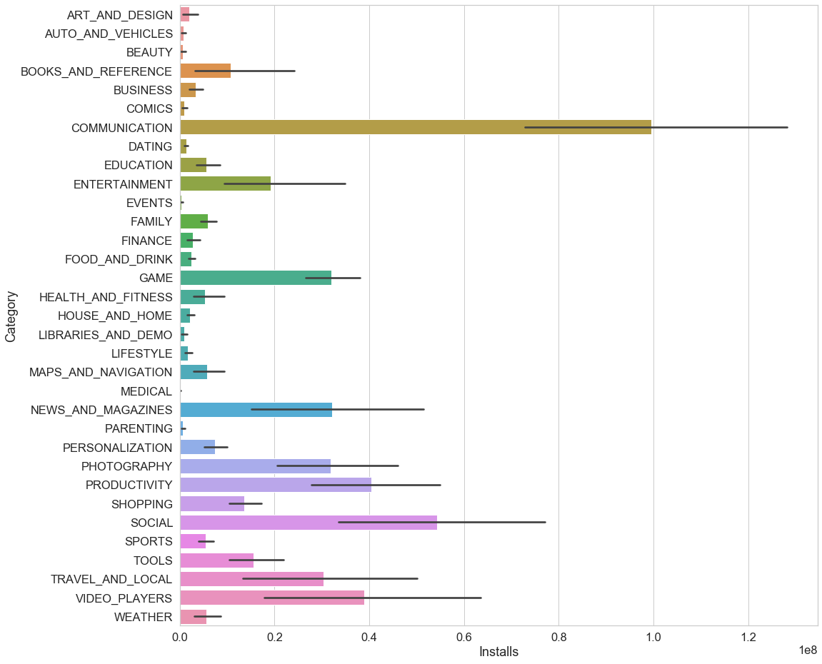
GRAPH VISUALIZATION
Insights : Though there’s a huge number of apps of category family , the total number of app that were installed are high for the categories communication and social.
The number of apps of category games is high and they also have a high popularity among the people.

Slide 7
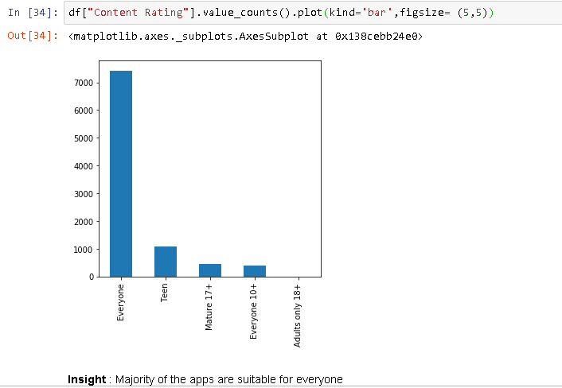
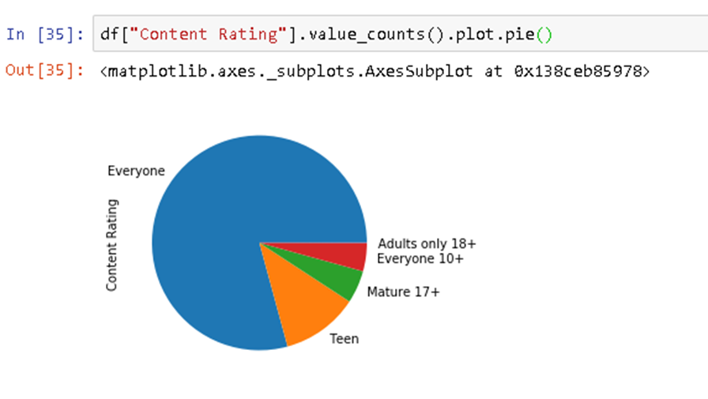
GRAPH VISUALISATIONS
GRAPH VISUALISATION

Slide 8
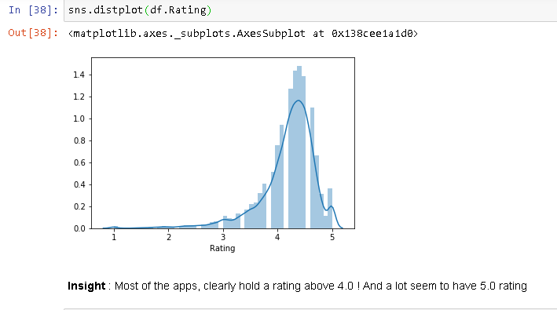
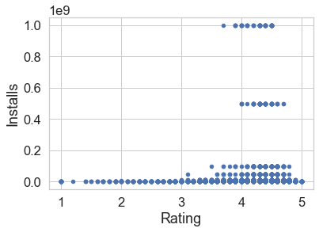
GRAPH VISUALISATIONS
THIS GRAPH IS LEFT SKEWED
INSIGHTS: here in this graph we can see clearly that the apps which have a higher rating have a high popularity among the population.

Slide 9
GRAPH VISUALISATIONS
INSIGHTS : Here in this graph we can see clearly that the apps which have a higher rating have a high popularity among the population and these apps have a higher number installs.

Slide 10
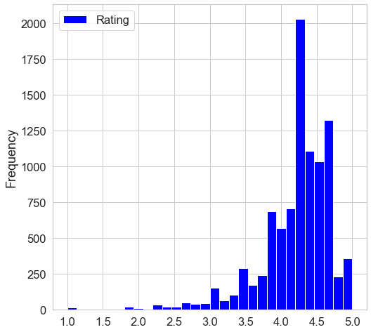
RATING VS FREQUENCY HISTOGRAM PLOT

Slide 11
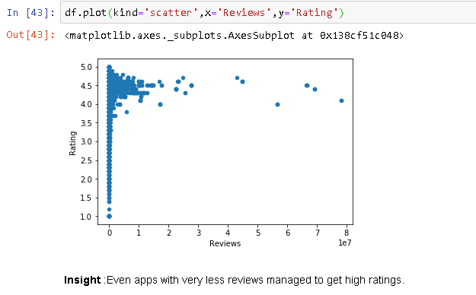
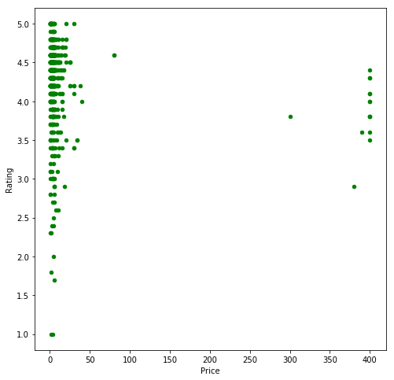
SCATTER PLOTS
INSIGHTS: Many free apps also got good rating

Slide 12
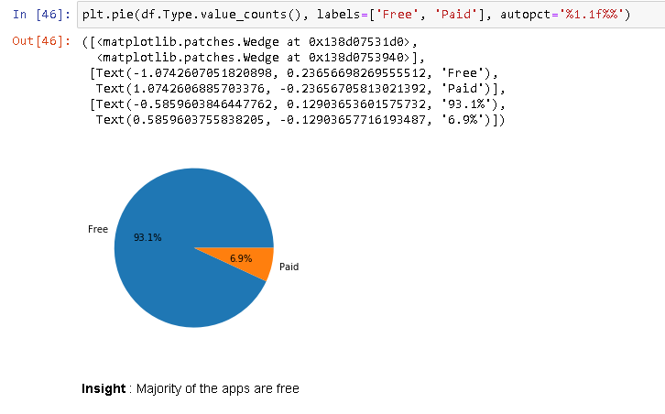
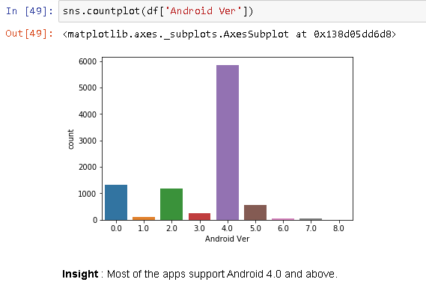

Slide 13
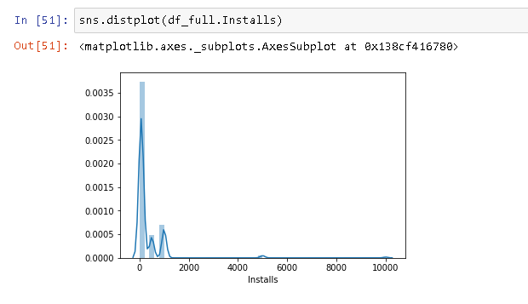
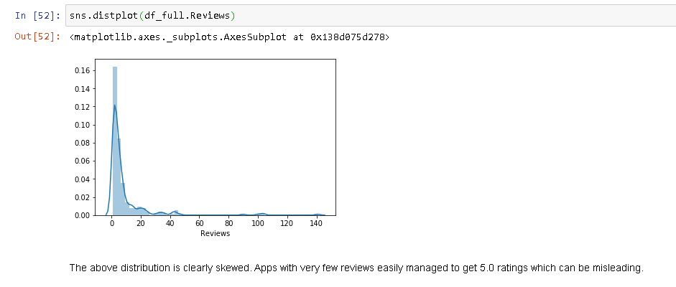
PLOT FOR NO. OF INSTALLS AND NO. OF REVIEWS FOR APPS WITH FULL RATING OF 5

Slide 14
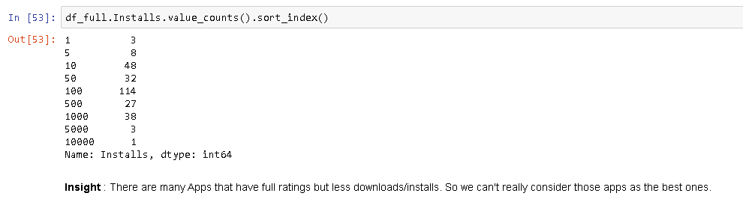
NUMBER OF INSTALLS FOR APPS WITH FULL RATINGS

Slide 15
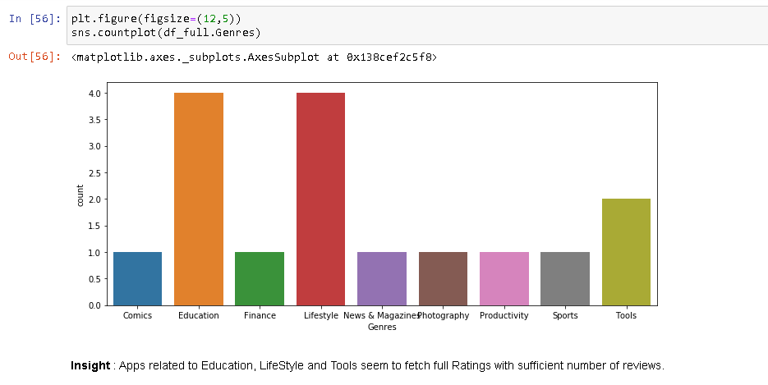
GENRES OF APPS WITH FULL RATING

Slide 16
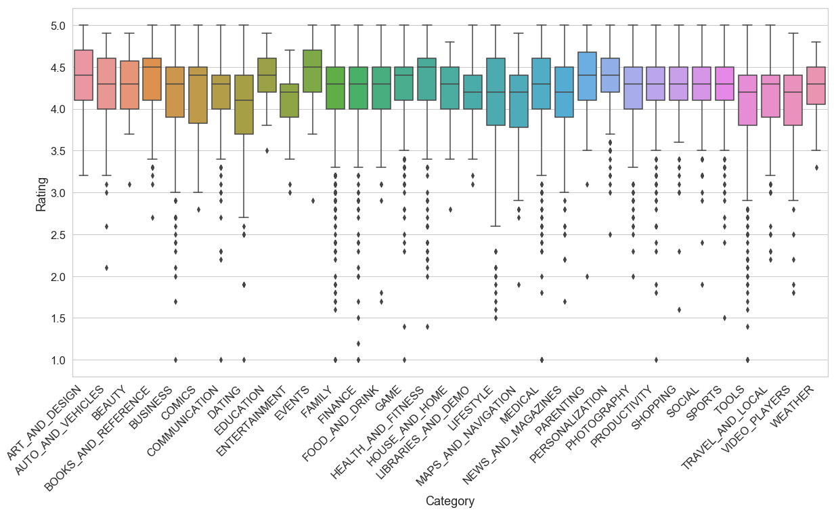
BOXPLOT FOR COMPARISON OF RATING AND CATEGORY

Slide 17
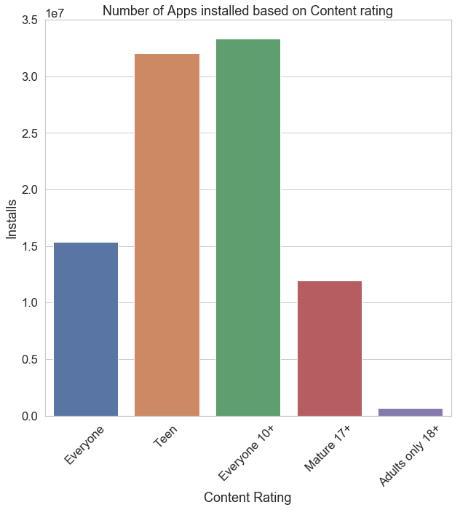
NUMBER OF APPS INSTALLED BASED ON CONTENT RATING

Slide 18
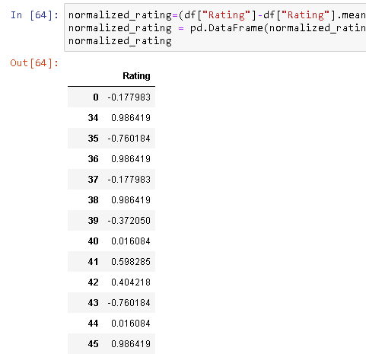
NORMALISATION MEAN=0 VARIANCE=1
NORMALISATION OF RATING
By making the ranges consistent between variables, normalization enables a fair comparison between the different features, making sure they have the same impact. It is also important for computational reasons.
The ratings are extremely skewed towards the high end of the total range so the transformation was not able to correct the skew as much as it would if it were less extreme.

Slide 19
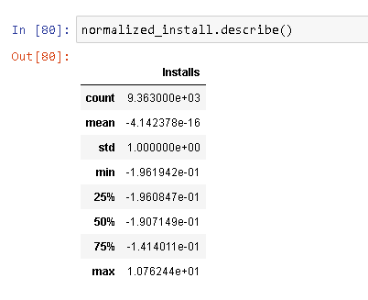
NORMALISATION OF RATING

Slide 20
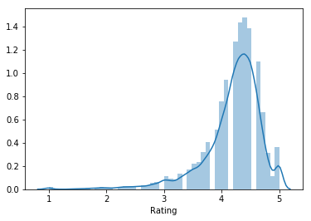
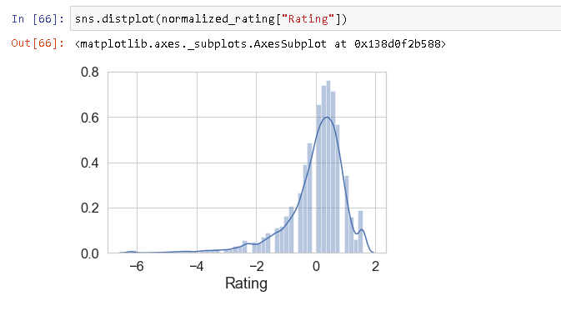
BEFORE NORMALISATION
AFTER NORMALISATION

Slide 21
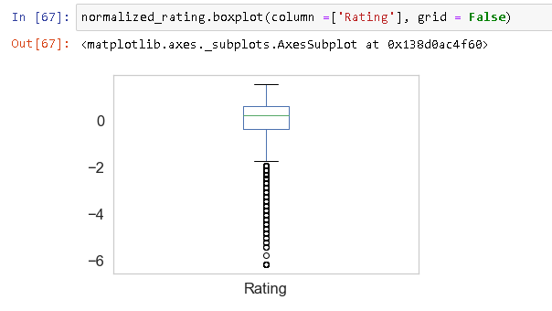
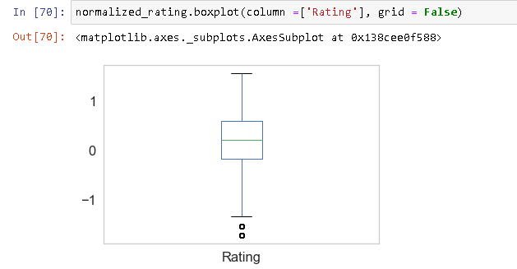
BEFORE REMOVING OUTLIERS
AFTER REMOVING OUTLIERS

Slide 22
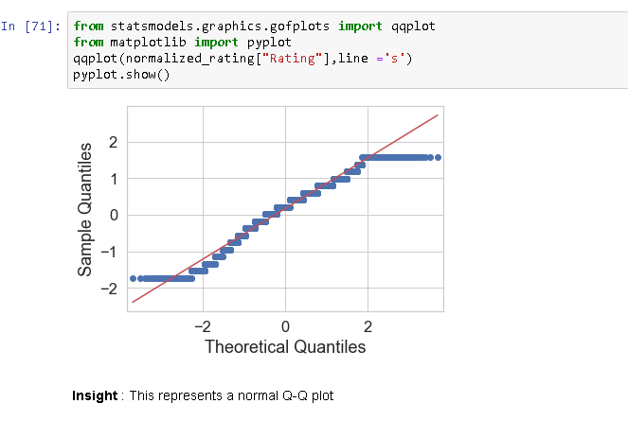
Q-Q PLOT FOR NORMALITY

Slide 23
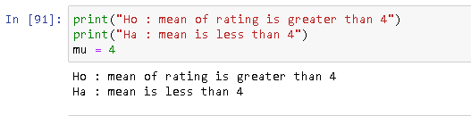
HYPOTHESIS TESTING
RATING

Slide 24
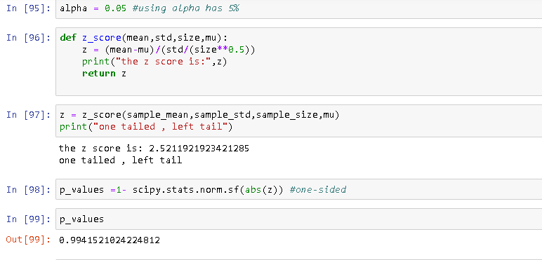
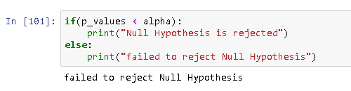
Hypothesis testing | z test

Slide 25
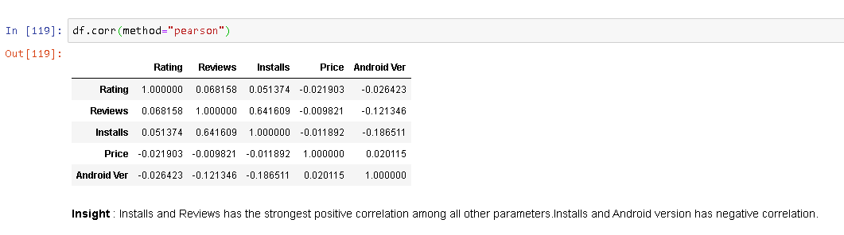
CORRELATION
PEARSON’S COEFFICIENT
INSTALLS AND REVIEWS ARE MODERATELY CORRELATED

Slide 26
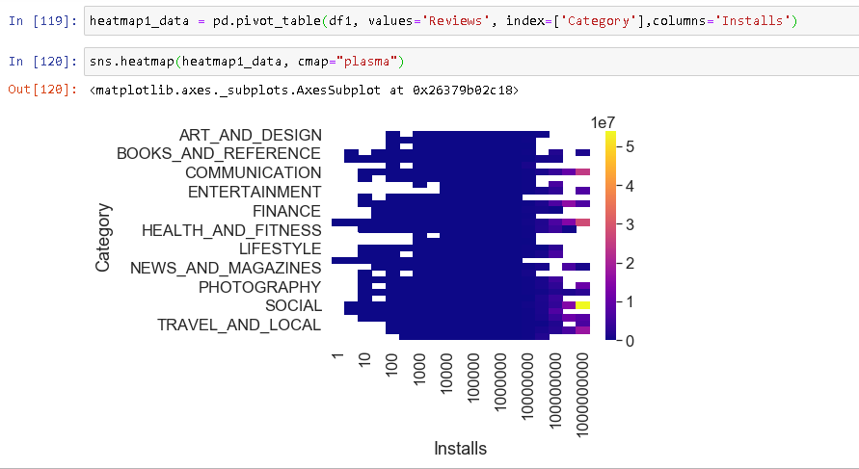
HEAT MAP INDICATING CORRELATION
Insight from this heat map is that apps with more reviews have a high number of installs

Slide 27
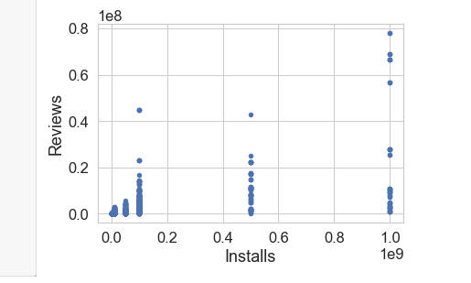
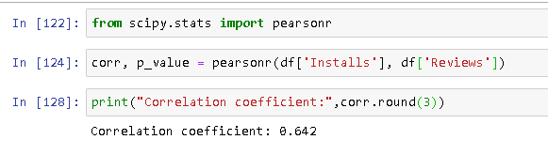
SCATTER PLOT FOR REVIEWS VS INSTALLS

